Slide 1
PiDFA : A Practical Multi-stride Regular Expression Matching Engine Based On FPGA
Author: Jiajia Yang, Lei Jiang, Qiu Tang, Qiong Dai, Jianlong Tan
Conference: IEEE ICC, 2016
Presenter: Kuan-Chieh Feng
Date: 2017/03/14
Department of Computer Science and Information Engineering
National Cheng Kung University
Notes:
1

Slide 2
Outline
Introduction
Detail of PiDFA
Hardware implementation
Performance Evaluation

Slide 3
Introduction
The multi-stride method is one way to increase the regex matching engine’s performance by processing multiple input characters per time.
It is not feasible to implement in NIDS practically for its huge memory requirement.

Slide 4
Introduction
To solve multi-stride algorithms’ memory explosion problem, we present a novel regex matching accelerating method called PiDFA (parallel-input DFA).
PiDFA takes the advantage of the parallelism of FPGA to accelerate regex matching.

Slide 5
Introduction
Through consuming k characters per time in pipeline, PiDFA yields a k-fold performance improvement than original DFA algorithm.
We apply two methods in PiDFA: DFA Transition Merging (DFA-TM) method and top-k state extraction method.

Slide 6
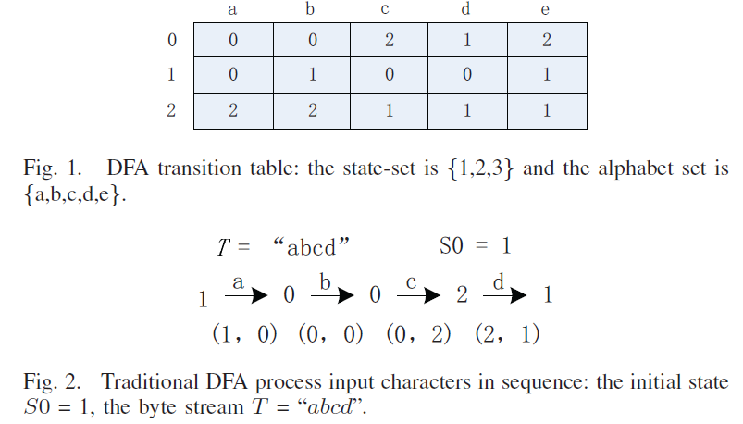
Detail of PiDFA – The DFA-TM method
Traditional DFA lookup

Slide 7
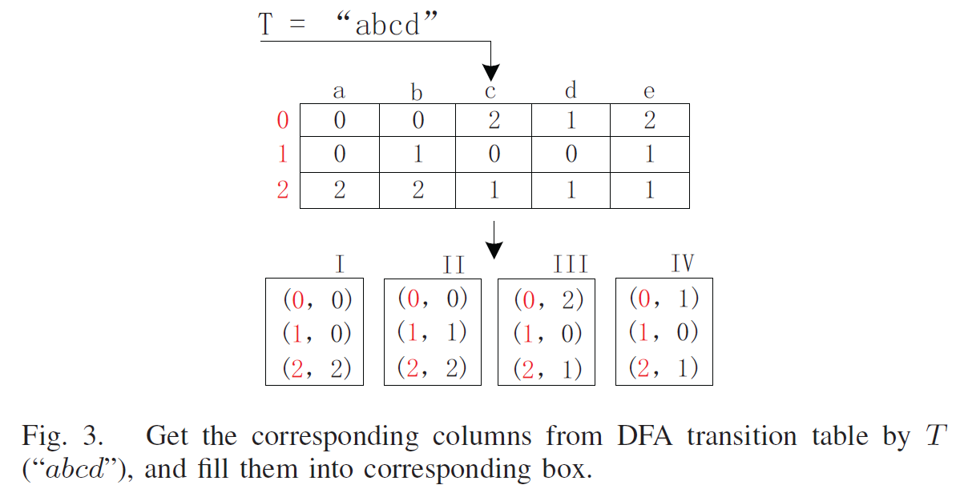
Detail of PiDFA - The DFA-TM method
Notes:
DFA-TM是一種動態的Look-up方法
首先利用input byte stream來對原始的DFA transition table

Slide 8
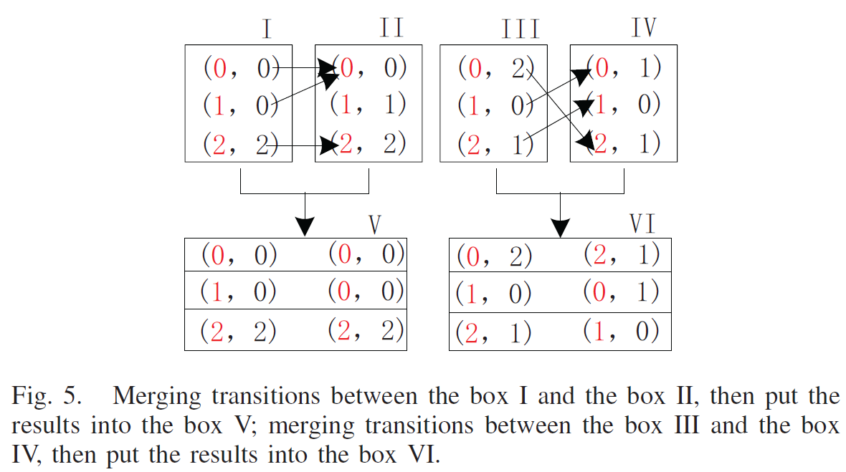
Detail of PiDFA - The DFA-TM method
Notes:
合併box的時候，我們根據第i列的括號右邊的值當作連接的依據 進行合併
另外這部分的過程是使用FPGA來做 因此box1與box2是同時得到的

Slide 9
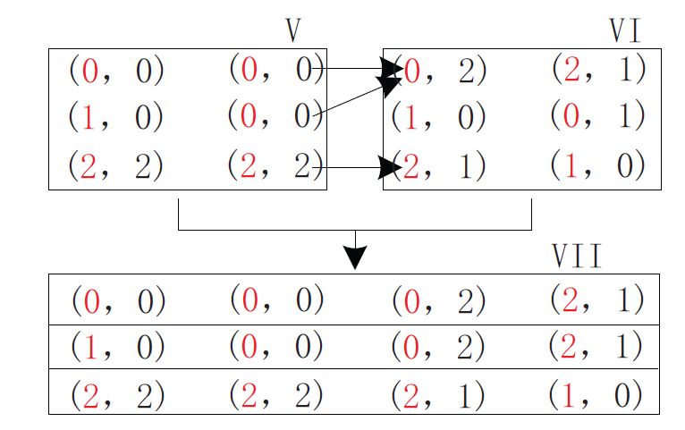
Detail of PiDFA - The DFA-TM method
After the box VII gets the result, a module, named “Validate Module” (VM), picks out the correct path in the box VII with the information of current state.

Slide 10
Detail of PiDFA - The DFA-TM method
Benefits and weakness of DFA-TM
  Benefit
    Use parallelism and pipeline to accelerate this process.
    We can scale up the number of boxes to process more characters per time,
  Weakness
    DFA-TM can only implemented by using logic resources (FF) and look-up tables (LUT) but not memory.
    If the number of state is too large , compiler tool can’t Place&Route.

Slide 11
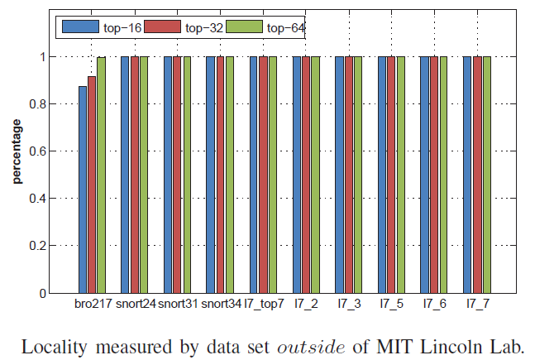
Detail of PiDFA - Top-k State extraction
Locality : A bulk of the DFA transitions are concentrated around a few DFA states.

Slide 12
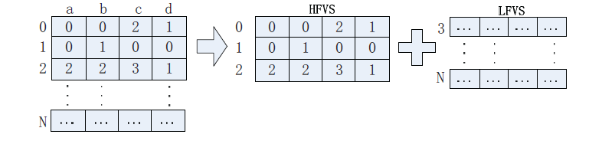
Detail of PiDFA - Top-k State extraction
According to “Locality”, we extract the most frequent states and store them into the “High Frequency Visit States” (HFVS) module.
The rest states are stored into the “Low Frequency Visit States” (LFVS) module.
Notes:
根據real case, 多數的input character都可以被HFVS來處理
如果failed 則會在讀取LFVS來處理，處理完後再回到HFVS。

Slide 13
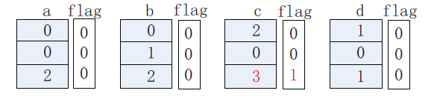
Detail of PiDFA - Top-k State extraction
We reorganize the DFA transition table and divide it into HFVS and LVFS. Then we add flag bits for each column of HFVS.
The flag bit represents whether the value of corresponding state is out of range of the states in the HFVS.

Slide 14
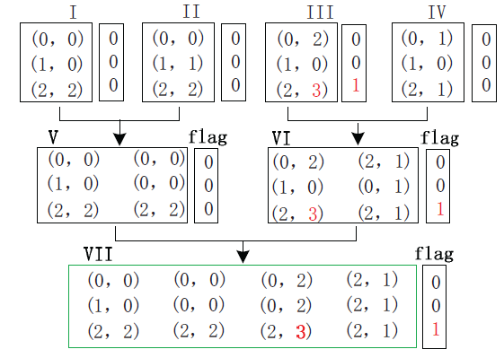
Detail of PiDFA - Top-k State extraction
Notes:
做search的時候，VM會根據current state以及input byte stream來選擇路徑
假如current state為0，則會選擇(0,0) (0,0) (0,2) (2,1)並且確認flag bit
如果flag bit為1則代表這個input stream會讀超過HFVS
因此再使用這個input byte stream到LFVS處理

Slide 15
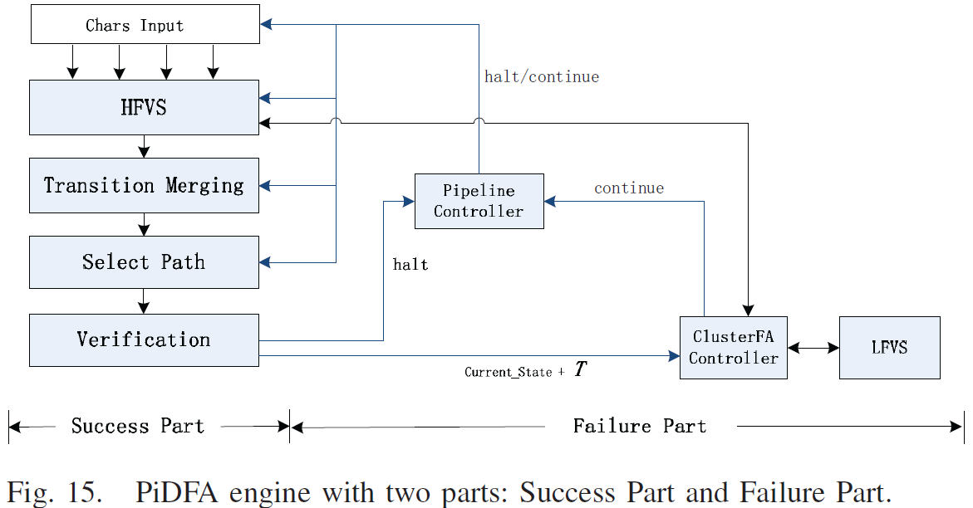
Hardware implementation
Notes:
Success的五個module會以pipeline的方式執行 假設沒有任何一個state大於在VM驗證時沒有大於HFVS的話
否則 VM會傳送halt給PCM，之後PCM會通知其他四個module暫停並且儲存current context
同時儲存在buffer內部的byte stream以及current state會傳給CACM來存取LFVS
最後當結果完成時 LFVS會儲存next state在buffer同時傳送continu訊號給PCM繼續下一輪的match

Slide 16
Hardware implementation
Chars Input Module (CIM)
HFVS
Transition Merging Module (TMM)
Select Path Module (SPM)
Verification Module (VM)
Pipeline Controller (PCM)
Compression Algorithm Controller Module (CACM)
LFVS

Slide 17
Performance Evaluation
OS : Ubuntu 12.4
CPU: i5-3470 Core, 3.20 GHz
Memory : 8G
Tool : Xilinx ISE 14.7
Xilinx Virtex-7 FPGA chip (XC7VX690T)
693,120 logic cells (LCs), and 52,920Kb BlockRAM

Slide 18
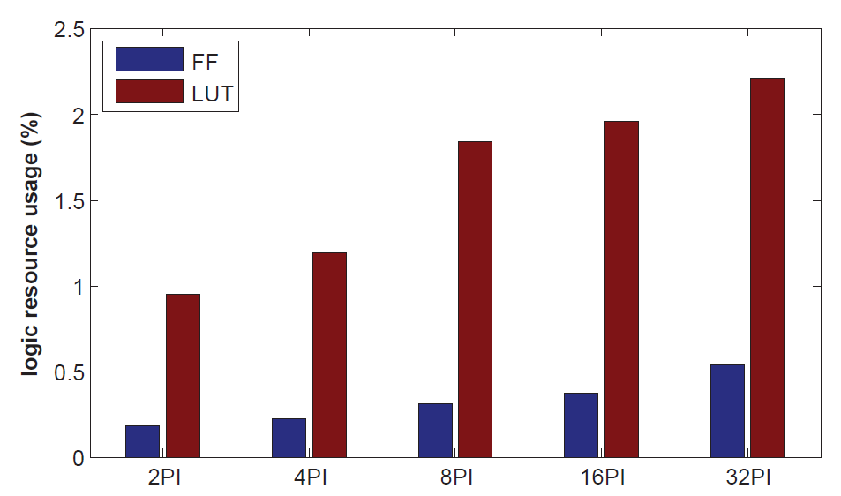
Performance Evaluation
Notes:
Input character

Slide 19
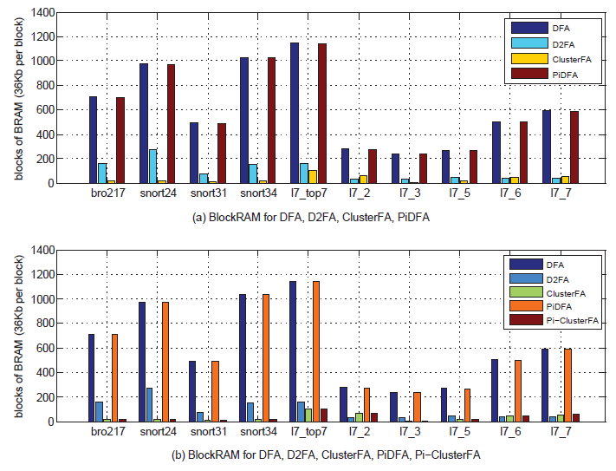
Performance Evaluation

Slide 20
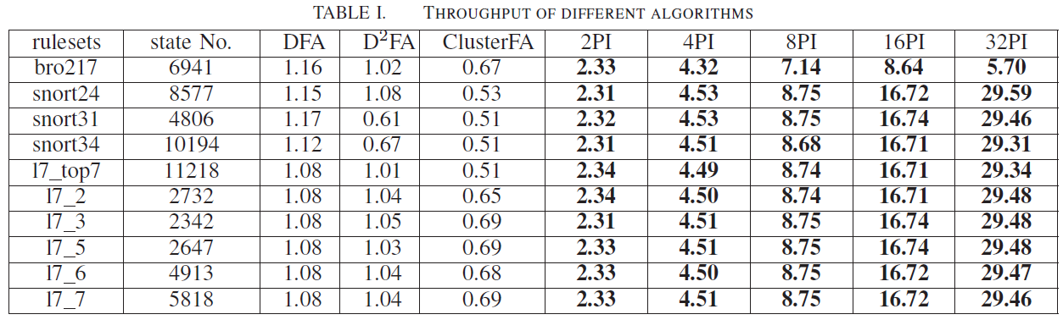
Performance Evaluation

Slide 21
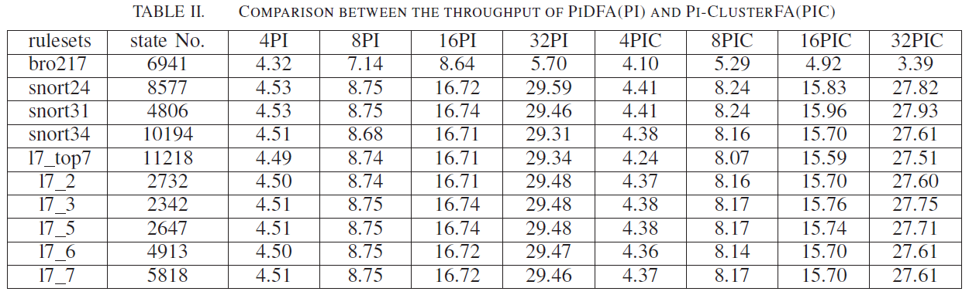
Performance Evaluation

